Slide 1
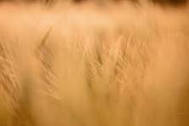
Wheat Crop Disease Detection and Analysis using Machine Learning
Advisor: Prof. Jerry Gao
Presenter: Prashansa Evangeline Bonapalle

Slide 2
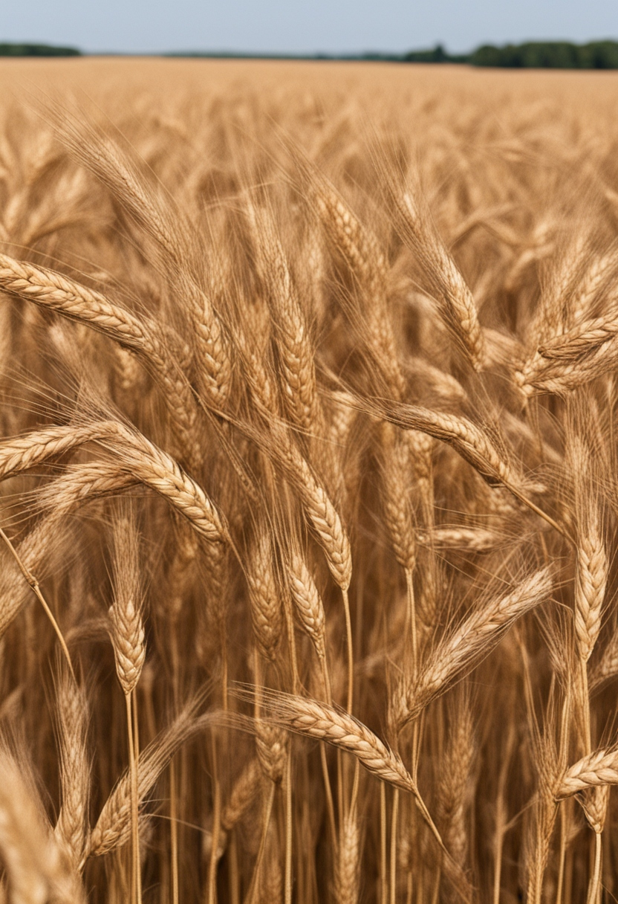
Introduction
Wheat is a staple food crop globally, essential for food security.
Early disease detection in wheat crops is crucial for maintaining high yields and quality.
Traditional methods are labor-intensive and often inaccurate.
This project introduces a machine learning approach using YOLOv5 for UAV imagery and VGG19, YOLOv4 for camera images to detect and classify wheat diseases.

Slide 3

Objectives
Develop machine learning models to accurately detect and classify wheat diseases:
Utilize deep learning architectures such as VGG19 for image classification and YOLOv5 for object detection.
Train models on UAV and high-resolution camera datasets.
Implement data augmentation techniques to enhance model robustness.
Evaluate model performance using precision, recall, F1-score, and mean Average Precision (mAP).
Create an early identification system for wheat crop diseases:
Implement real-time monitoring using UAVs and camera systems.
Develop a user interface for image upload and instant disease diagnosis.
Integrate early warning alerts for timely intervention.

Slide 4
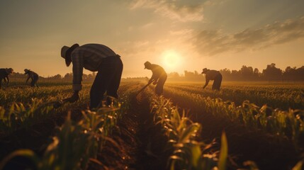
Traditional Methods
Manual Visual Inspection:
Performed by agricultural experts.
Involves physical examination of plants.
Laboratory Testing:
Involves sample collection and laboratory analysis.
Uses biochemical tests to identify pathogens.
Basic Image Processing:
Uses simple image analysis techniques.
Limited by the accuracy of traditional algorithms.
Limitations:
Time-consuming and labor-intensive.
Requires expert knowledge and experience.
Prone to human error and inconsistency.

Slide 5

Project Overview
Machine Learning Techniques:
Used of deep learning models like VGG19, YOLOv5 and YOLOv4 for object detection.
Data Sources:
Utilization of UAV and high-resolution camera imagery.
Model Implementation:
Implementation of YOLOv5 for UAV imagery and VGG19 and YOLOv4 for camera images.
Dataset Collection and Preprocessing:
Comprehensive collection of datasets, including approximately 3100 UAV images and 4600 camera images

Slide 6
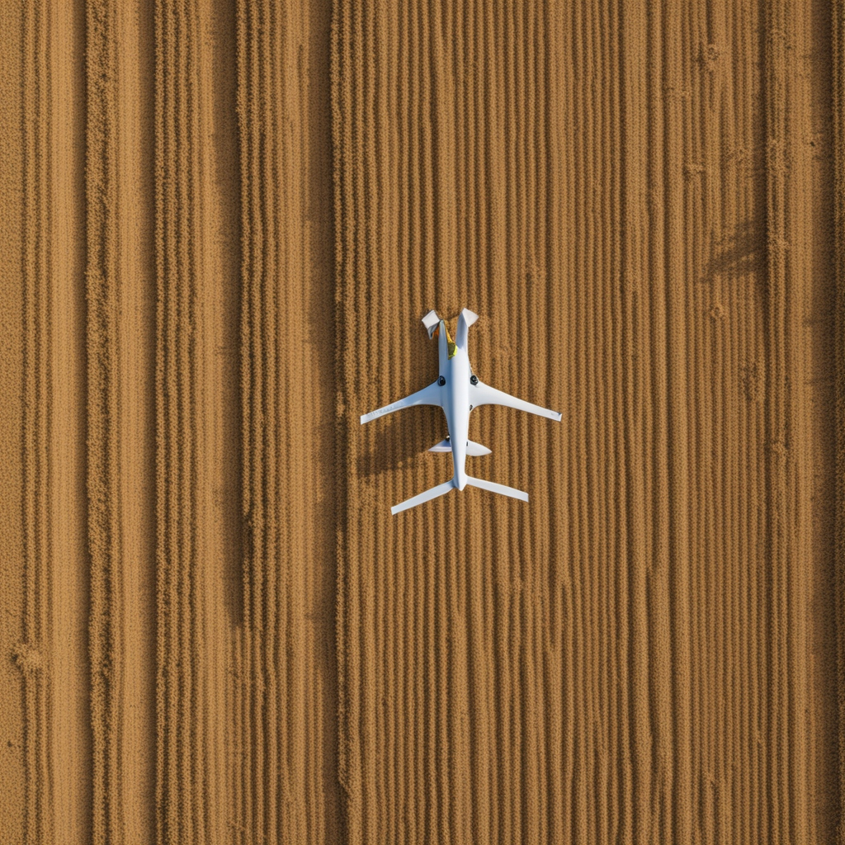
UAV Dataset
Source: DJI Drone Imagery
Classes: Fusarium Head Blight, Healthy Head
Total Images:Approximately 3100
Images captured at various altitudes to simulate different field scouting scenarios.

Slide 7
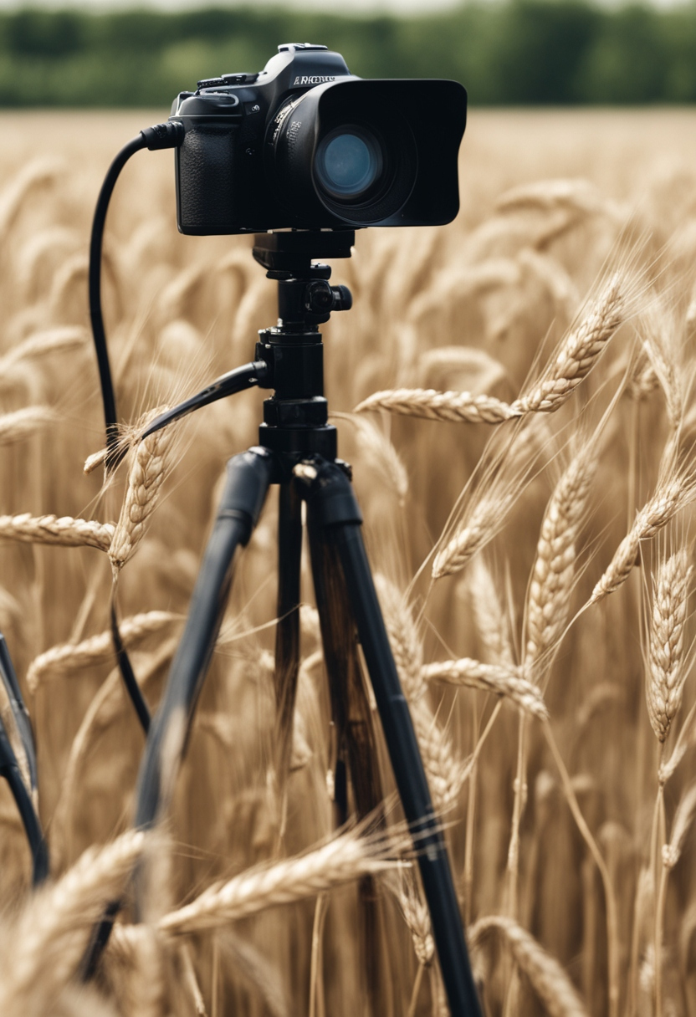
Camera Dataset
Source: Ground-based high-resolution camera
Classes: Crown and Root Rot, Healthy Wheat, Leaf Rust, Wheat Loose Smut
Total Images: Approximately 4600
Diverse set of images taken in different lighting and weather conditions.

Slide 8
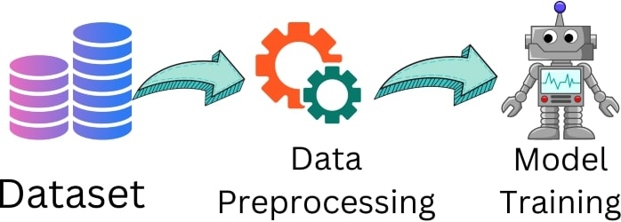
Data Preprocessing
Techniques Used:
Resizing images to the required input dimensions for each model.
Normalization to standardize pixel values.
Contrast improvement to enhance image features.
Noise reduction to remove artifacts.
Data augmentation (flipping, scaling, rotating) to increase dataset diversity.

Slide 9
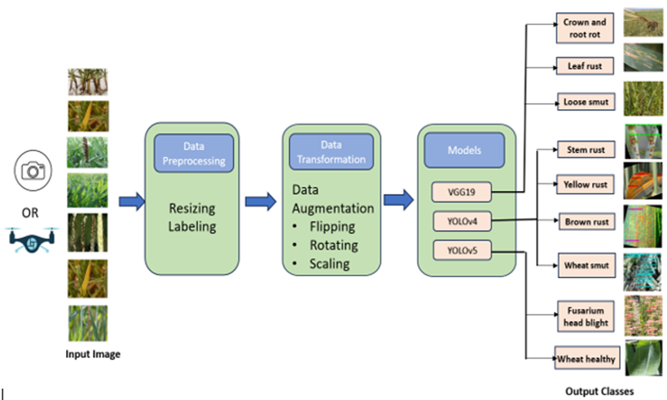
Workflow Diagram
The diagram illustrates the workflow from input image acquisition using UAVs or cameras, followed by data preprocessing (resizing and labeling), data transformation through augmentation (flipping, rotating, scaling)
Finally the application of models (VGG19, YOLOv4, YOLOv5) to classify wheat diseases into various output classes.

Slide 10
VGG19 Model
Model Description:
VGG19 is a deep convolutional neural network with 19 layers, renowned for its performance in image recognition tasks. In the context of crop disease detection, VGG19 is employed to meticulously analyze images of wheat plants, identifying specific disease features with high accuracy. Its deep architecture allows it to capture intricate patterns and details in the images, making it highly effective for detecting various wheat diseases.

Slide 11
YOLOv5 Model
Model Description:
YOLOv5 is a state-of-the-art real-time object detection model known for its exceptional balance between speed and accuracy. In this application, YOLOv5 is used to detect wheat crop diseases swiftly and accurately from images. By processing the images in real-time, it can identify and classify disease symptoms, providing immediate feedback to farmers and agronomists. This rapid detection capability is crucial for timely disease management and intervention in wheat crops.

Slide 12

Training VGG19
Steps:
Resize images to 224x224 pixels.
Split data into training, validation, and testing sets.
Use the Adam optimizer with a learning rate of 0.001.
Train the model for 30 epochs to avoid overfitting while ensuring sufficient learning.
Transfer Learning:
Use pre-trained weights from VGG19 to improve learning efficiency.
Evaluation:
Monitor training and validation accuracy and loss.

Slide 13

Training YOLOv5
Steps:
Resize images to 640x640 pixels.
Set initial learning rate to 0.01, reducing to 10% by the end of training.
Train the model for 75 epochs with a batch size of 32.
Use extensive training to learn varied patterns of diseases.
Evaluation:
Evaluate model performance using precision, recall, and mAP.
Hyperparameter Tuning:
Adjust hyperparameters such as learning rate and batch size for optimal performance.

Slide 14
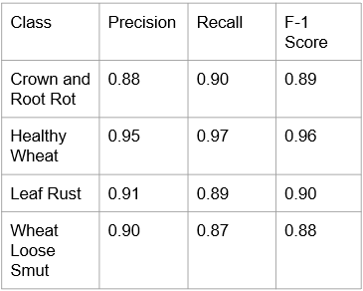
VGG19 Performance
The VGG19 model demonstrates high accuracy and reliability in classifying various wheat diseases with precision and recall metrics ranging from 0.87 to 0.97, ensuring effective disease management.

Slide 15
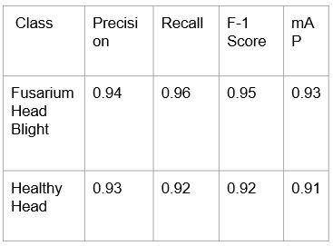
YOLOv5 Performance
The YOLOv5 model shows excellent performance in detecting Fusarium Head Blight and Healthy Head, with precision, recall, and F1-score all above 0.90, and mAP values of 0.93 and 0.91 respectively

Slide 16

Comparative Analysis
Strengths:
VGG19 excels in image classification: It is well-suited for tasks that require detailed classification of images into specific categories.
YOLOv5 excels in real-time object detection: It is optimized for detecting and localizing objects within an image, making it ideal for applications that need quick and precise detection.
Conclusion:
VGG19:
Ideal for broad-spectrum disease detection with high reliability.
Best deployed for consistent, widespread monitoring of diseases.
YOLOv5:
Optimal for targeted detection tasks requiring high precision.
Best used for specialized applications needing detailed and precise disease identification.

Slide 17

Challenges
GPU memory limitations during model training.
Overfitting issues due to small training datasets.
Processing large batch sizes efficiently.
Handling variations in lighting conditions in the images.

Slide 18

Solutions
Implemented Solutions:
Data Augmentation: Increase dataset size and diversity.
Hyperparameter Tuning: Optimize learning rate, batch size, and epochs.
Early Stopping: Prevent overfitting by stopping training early when performance plateaus.
Efficient Data Handling: Use techniques to manage large batch sizes and memory usage.

Slide 19
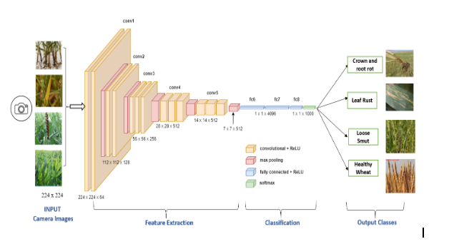
VGG19 Model Achitecture
Architecture Details:
Feature Extraction:
Conv1: Two convolutional layers (64 filters, 3x3 kernel, ReLU activation) followed by max pooling.
Conv2: Two convolutional layers (128 filters, 3x3 kernel, ReLU activation) followed by max pooling.
Conv3: Four convolutional layers (256 filters, 3x3 kernel, ReLU activation) followed by max pooling.
Conv4: Four convolutional layers (512 filters, 3x3 kernel, ReLU activation) followed by max pooling.
Conv5: Four convolutional layers (512 filters, 3x3 kernel, ReLU activation) followed by max pooling.
Classification:
Fully Connected Layers:
FC6: 4096 neurons, ReLU activation.
FC7: 4096 neurons, ReLU activation.
FC8: 1000 neurons, softmax activation.
Output Layer: Softmax activation to classify the image into one of the four classes.

Slide 20
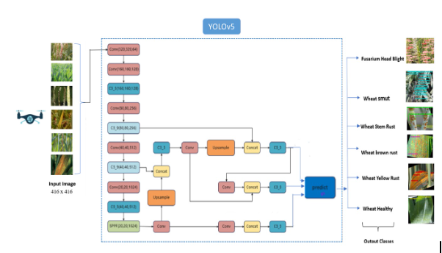
YOLOv5 Model Architecture
Architecture:
Backbone:
Convolutional layers with varying filter sizes.
CSP (Cross Stage Partial) layers for feature extraction.
SPP (Spatial Pyramid Pooling) layer for multi-scale feature aggregation.
Neck:
PANet (Path Aggregation Network) for feature fusion.
Upsample and Concat operations to combine features from different layers.
Head:
Convolutional layers for bounding box prediction.
Detection layers to output class probabilities and bounding box coordinates.

Slide 21
YOLOv4 Model
Overview:
Input: UAV images resized to 416x416 pixels.
Output Classes: Fusarium Head Blight, Wheat Smut, Wheat Stem Rust, Wheat Brown Rust, Wheat Yellow Rust, Healthy Wheat.
Architecture:
Backbone:
CSPDarknet53: A combination of Cross Stage Partial networks and Darknet53 for robust feature extraction.
Convolutional Layers: Multiple layers with different filter sizes to capture diverse features.
Neck:
SPP (Spatial Pyramid Pooling): Aggregates context information at different scales.
PANet (Path Aggregation Network): Enhances feature pyramid with top-down and bottom-up pathways for better information flow.
Head:
YOLO Head: Predicts bounding boxes and class probabilities.
Detection Layers: Outputs final detections with class scores and bounding box coordinates.

Slide 22
Model Evaluation Methods
Evaluation Methods for VGG19:
Accuracy: Measures the overall correctness of the model.
Precision: Ratio of true positives to the sum of true and false positives.
Recall: Ratio of true positives to the sum of true positives and false negatives.
F1-score: Harmonic mean of precision and recall.
Confusion Matrix: Displays the performance of the model by showing true positives, true negatives, false positives, and false negatives.
Evaluation Methods for YOLOv5:
IoU (Intersection over Union): Measures the overlap between predicted and ground truth bounding boxes.
mAP (mean Average Precision): Evaluates the precision and recall across different IoU thresholds.
FPS (Frames Per Second): Assesses the speed of the model in real-time detection tasks.

Slide 23
Model Validation
Use of a Validation Dataset:
Split the dataset into training and validation sets.
Use the validation set to tune hyperparameters and optimize model performance.
Ensuring Model Generalization:
Test the model on unseen data to evaluate its generalization ability.
Validate the model's performance to ensure it can handle new, unseen samples effectively.
Avoiding Overfitting:
Monitor validation accuracy and loss during training.
Implement early stopping if validation performance starts to degrade.
Use techniques such as dropout and data augmentation to improve model robustness and prevent overfitting.

Slide 24
Steps for Model Validation for YOLOv5
Use of a Validation Dataset:
Split the dataset into training and validation sets.
Use the validation set to fine-tune hyperparameters and optimize model performance.
Ensuring Model Generalization:
Test the model on unseen data to evaluate its generalization capability.
Validate the model's performance to ensure it can accurately detect objects in new, unseen images.
Avoiding Overfitting:
Monitor validation accuracy and loss during training.
Implement early stopping to halt training if validation performance starts to decline.
Use techniques such as data augmentation and regularization to enhance model robustness and prevent overfitting.

Slide 25
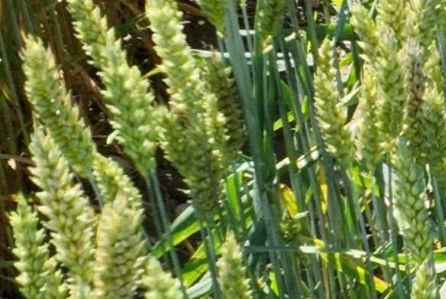
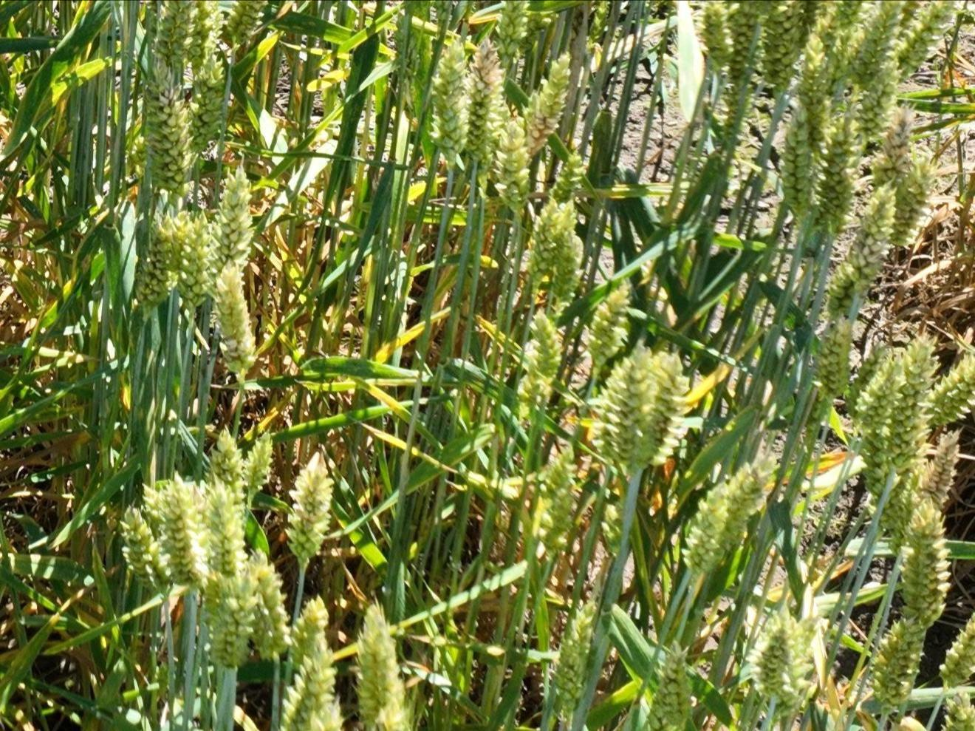
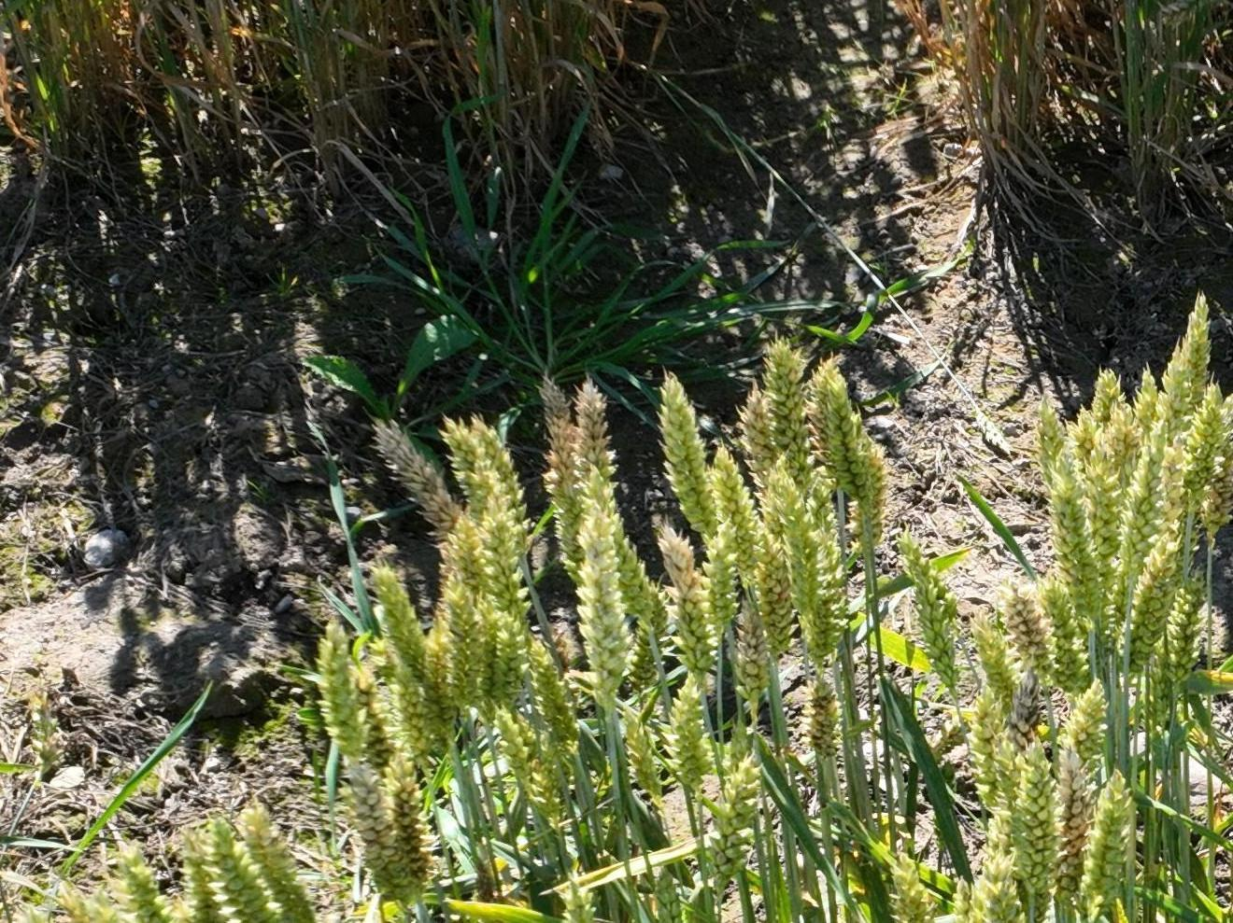
UAV Image Samples
Fig. 1 a Fig. 1b Fig. 1c

Slide 26

Future Enhancements
1. Expanding Training Datasets:
Diverse Data: Collect images from various conditions and locations.
Synthetic Data: Use GANs to generate additional training images.
2. Refining Algorithms:
Advanced Architectures: Implement newer neural network models.
Hyperparameter Optimization: Use tools like Grid Search for tuning.
Ensemble Methods: Combine models to improve accuracy.
3. Integration with IoT and Edge Computing:
Real-Time Monitoring: Deploy models on edge devices for immediate detection.
IoT Connectivity: Use IoT networks for comprehensive data collection.
4. Enhancing Model Interpretability:
Explainable AI (XAI): Implement techniques for better model transparency.

Slide 27
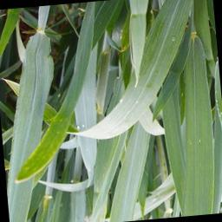
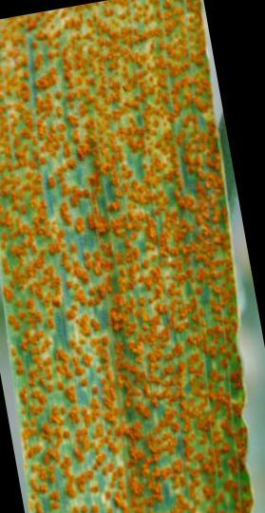
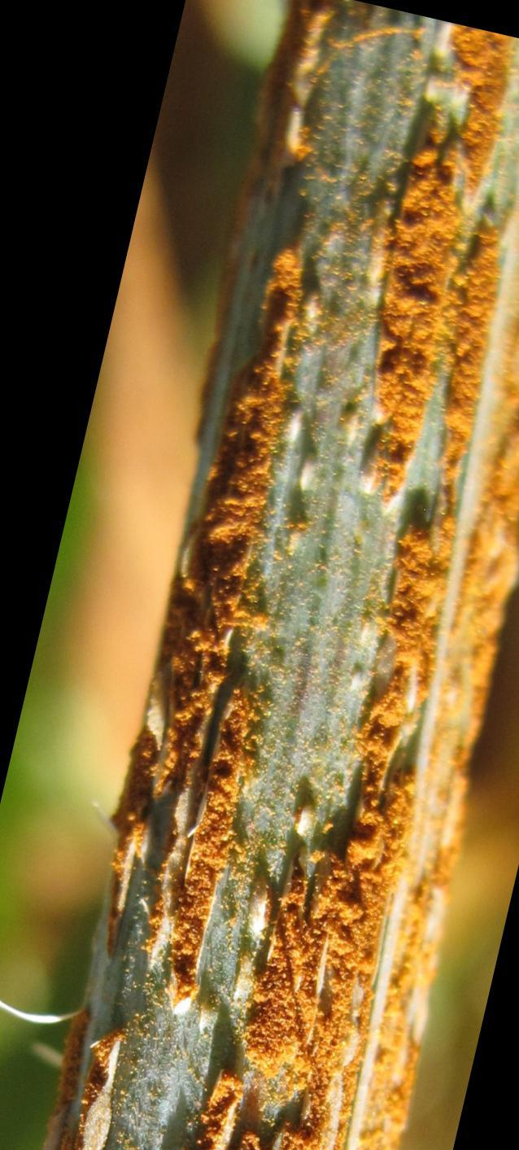
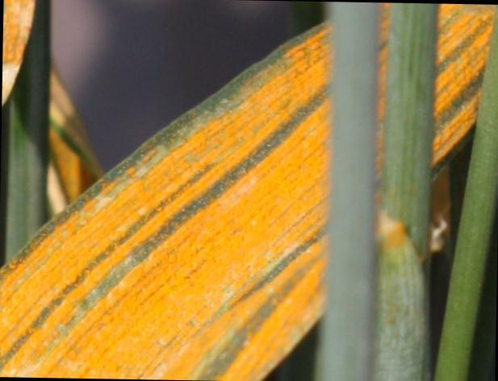
Camera Image Samples
Fig 2a. Healthy Wheat Fig 2b. Leaf Rust Fig 2c. Stem Rust Fig 2d. Yellow Rust

Slide 28
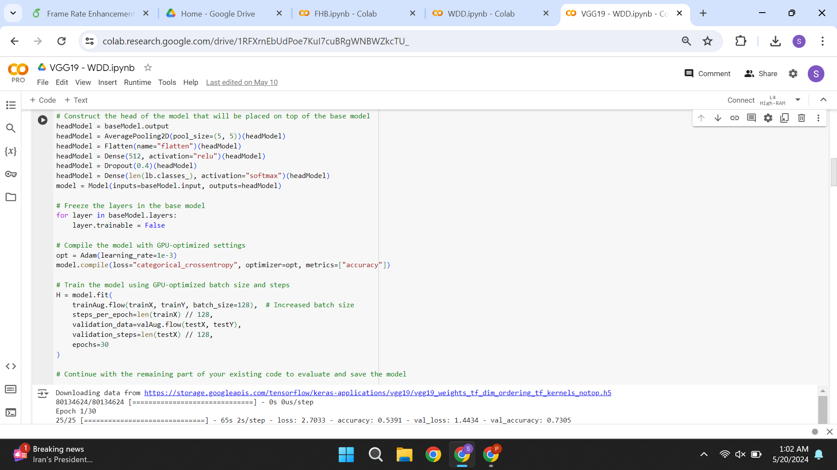
VGG19 Code Snippet

Slide 29
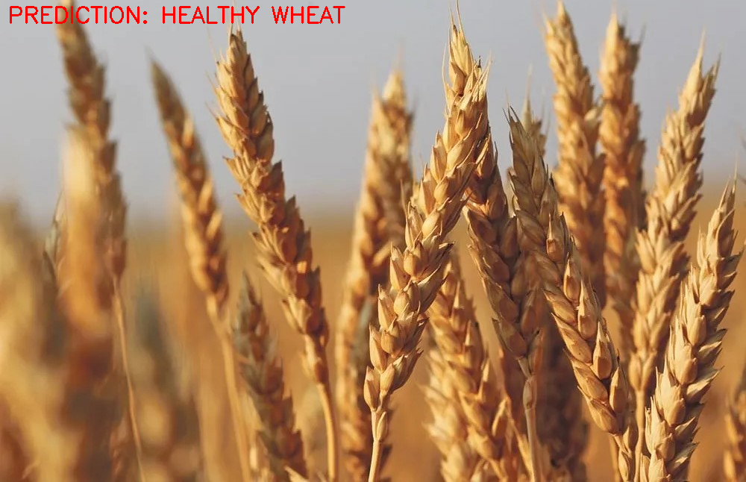
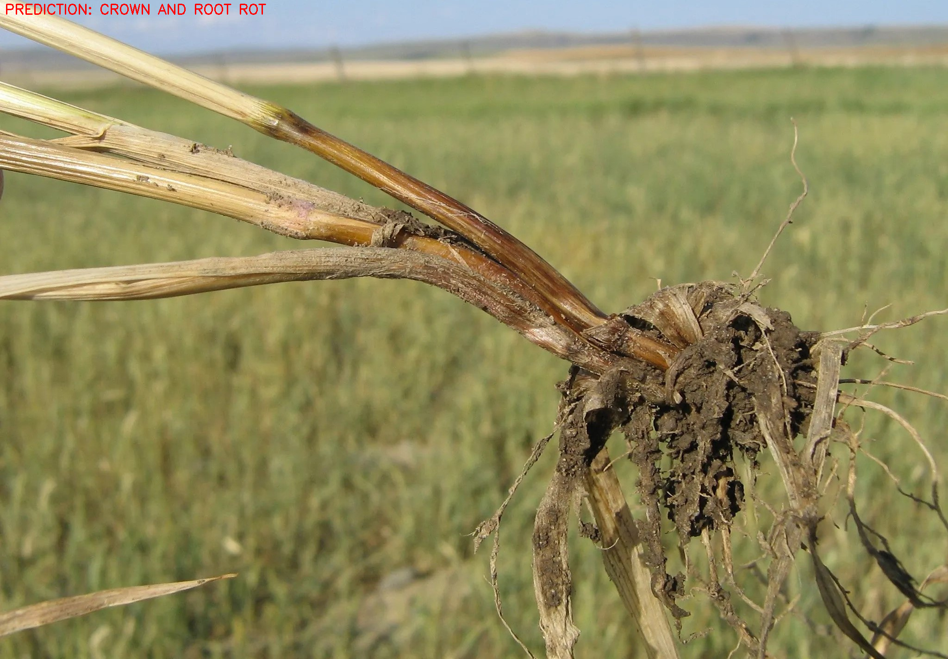
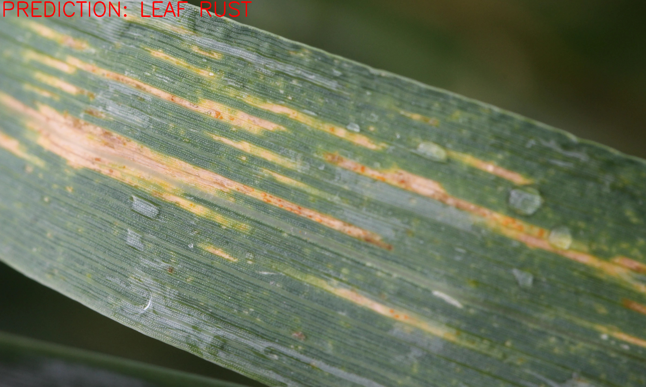
VGG19 Training Graphs
Fig. 3 a Fig. 3b Fig. 3c

Slide 30
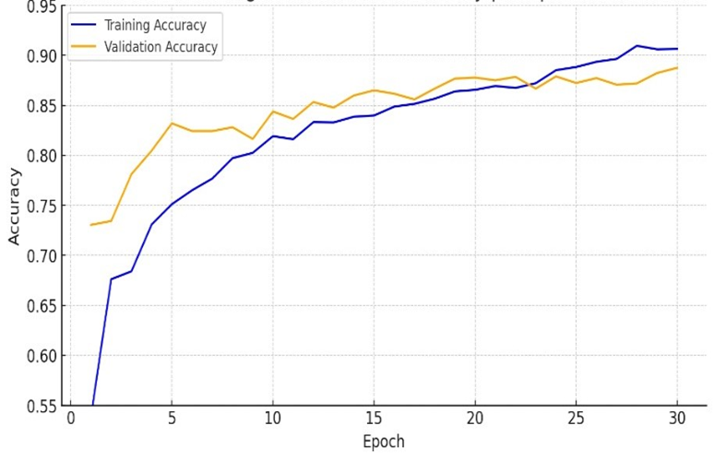
VGG19 Training and Validation Accuracy per Epoch Graph

Slide 31
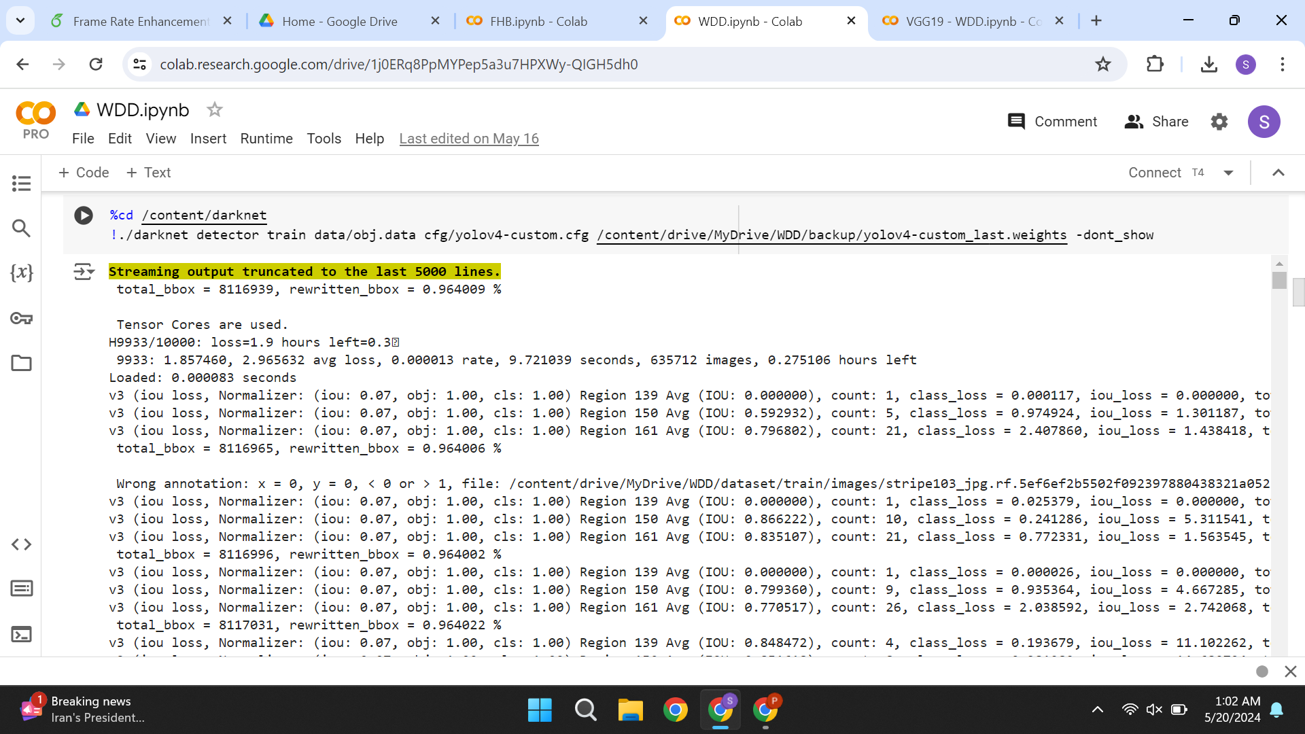
Yolov4 Code Snippet

Slide 32
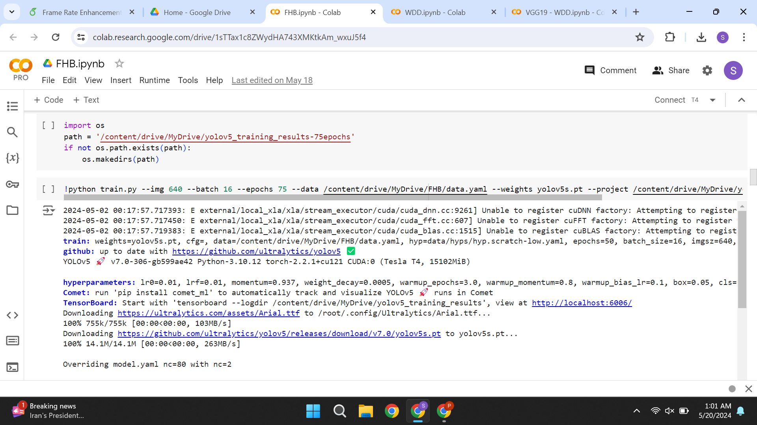
YOLOV5 Code Snippet

Slide 33
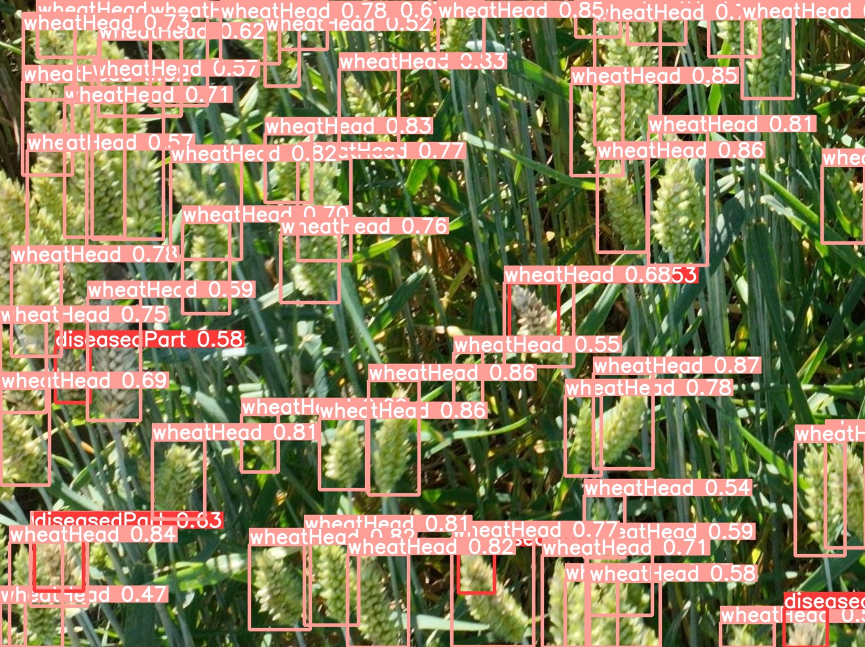
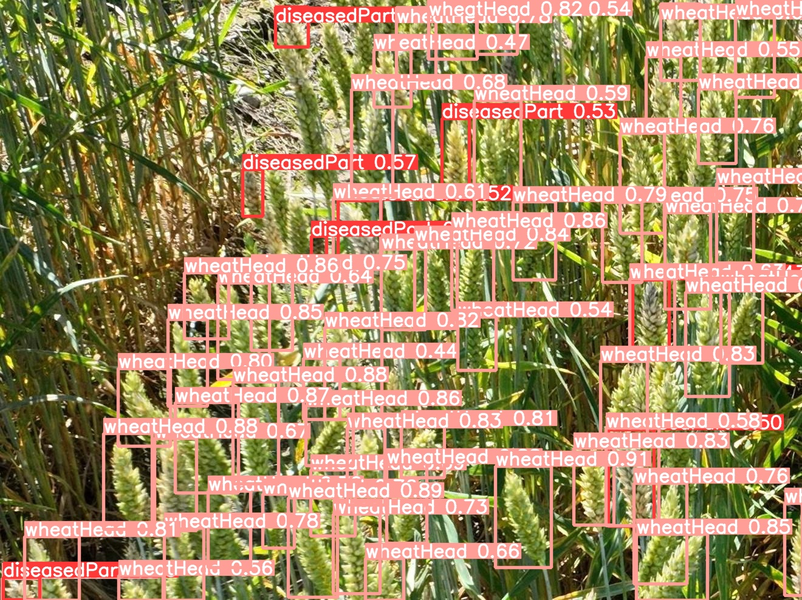
YOLOv5 results
Fig. 6a Fig. 6b

Slide 34
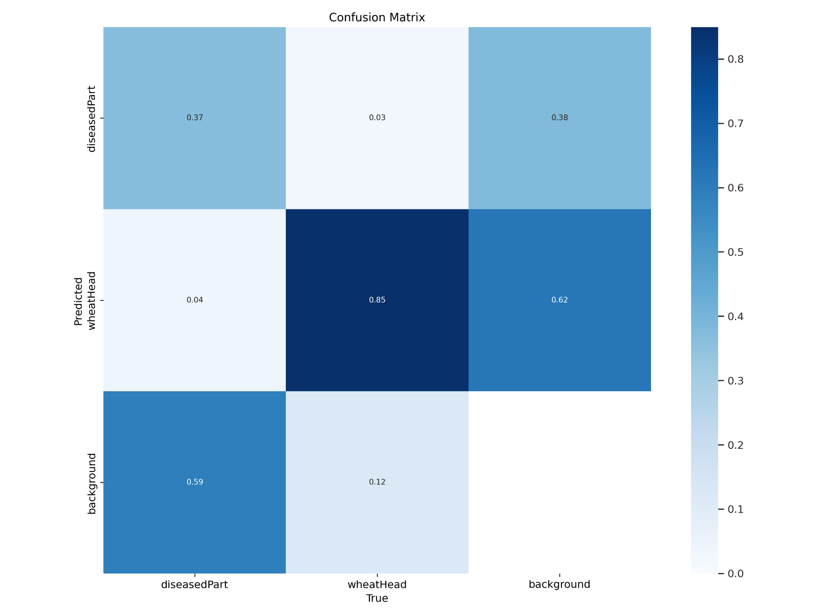
YOLOv5 Confusion Matrix
Fig. 4 Confusion Matrix

Slide 35
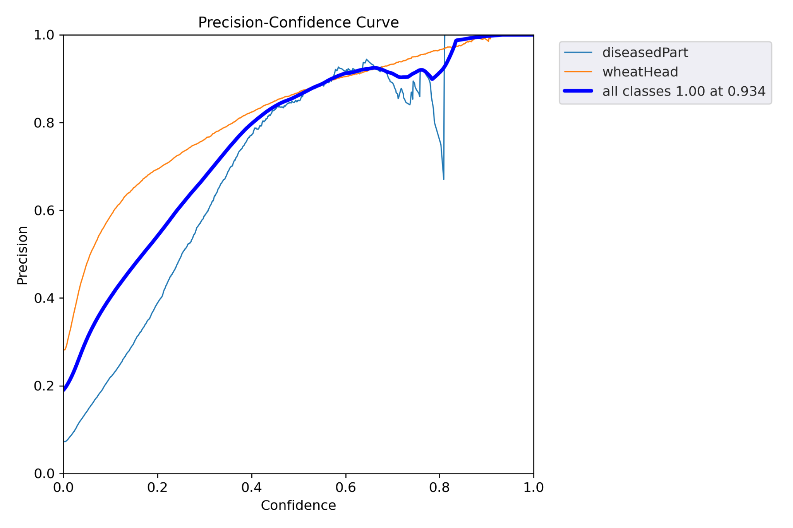
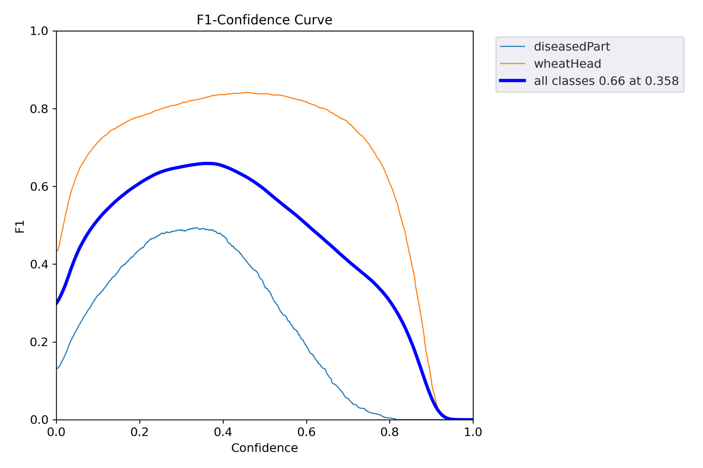
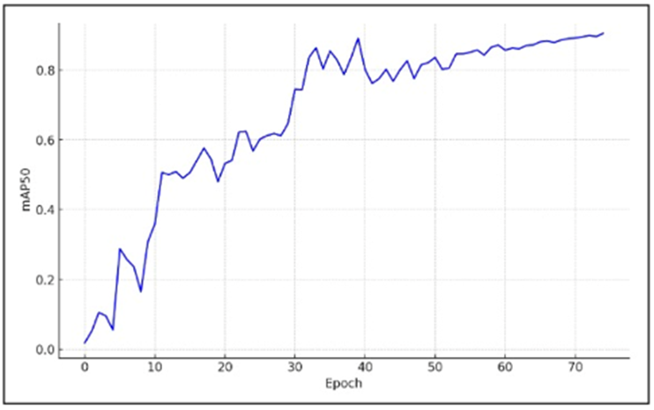
YOLOv5 Graphs
Fig 5a. mAP50 vs Epoch Graph for YOLOv5 Fig 5b. Precision - Confidence Curve Fig 5c.. F1-Confidence Curve

Slide 36
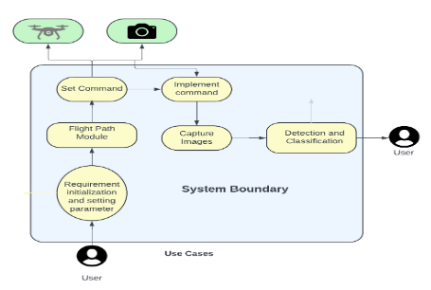
Use Case Diagram
Use case diagram of a wheat crop disease detection system, illustrating the process from user commands to the implementation of commands by drones and cameras for capturing images and classifying diseases

Slide 37
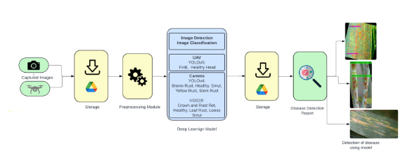
System Design
This slide depicts the workflow of a deep learning-based wheat crop disease detection system, from capturing and storing images, preprocessing, classification using YOLO and VGG models, to generating a detailed disease detection report.

Slide 38
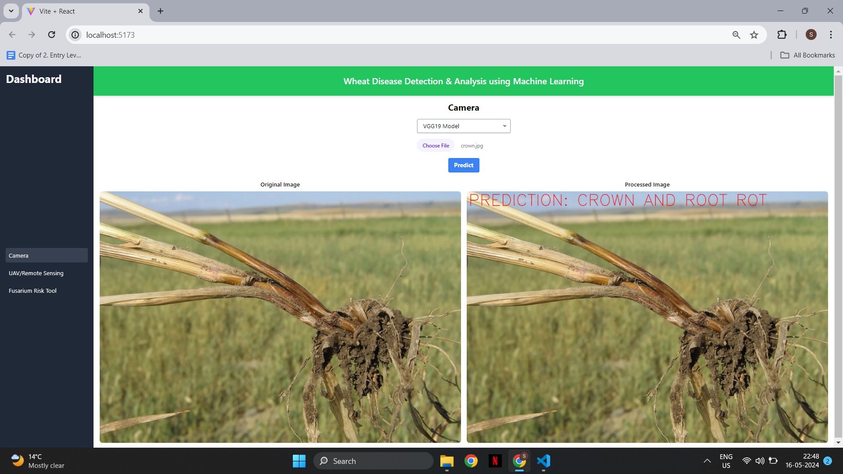
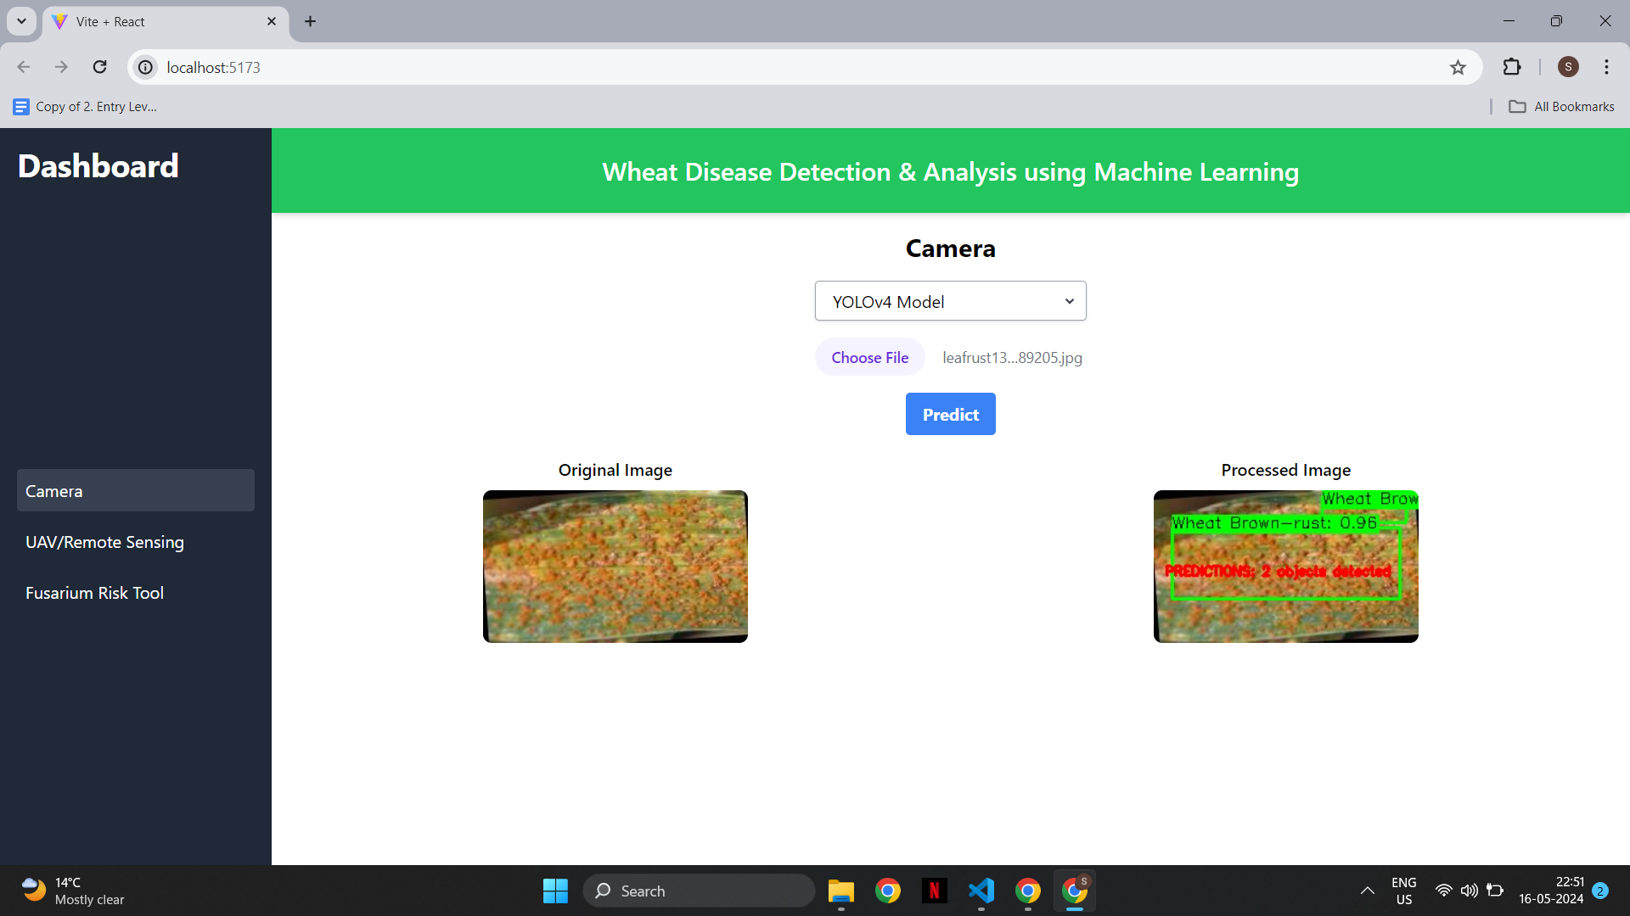
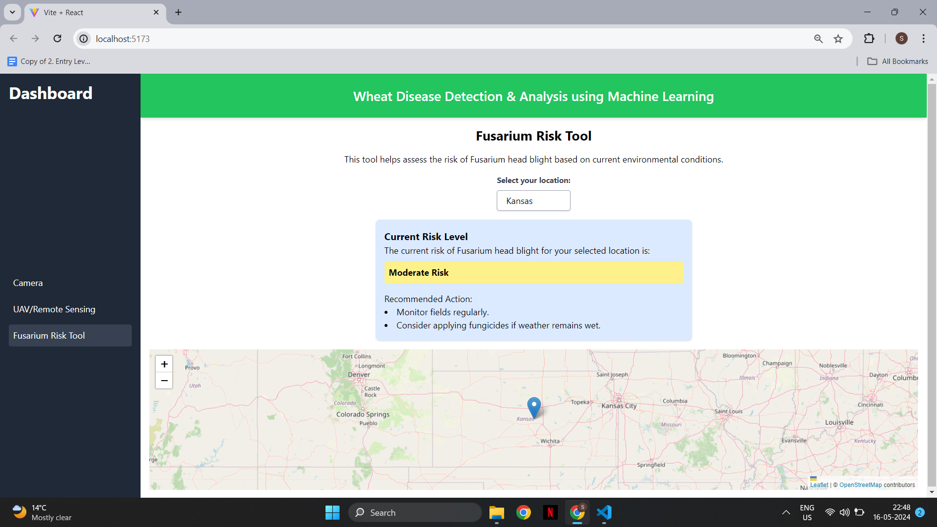
User Interface
This UI is designed for detecting and analyzing wheat crop diseases using machine learning models like YOLOv4 and VGG19, providing real-time predictions and risk assessments. It includes tools for camera-based disease detection, UAV/remote sensing, and a Fusarium risk assessment based on current environmental conditions

Slide 39
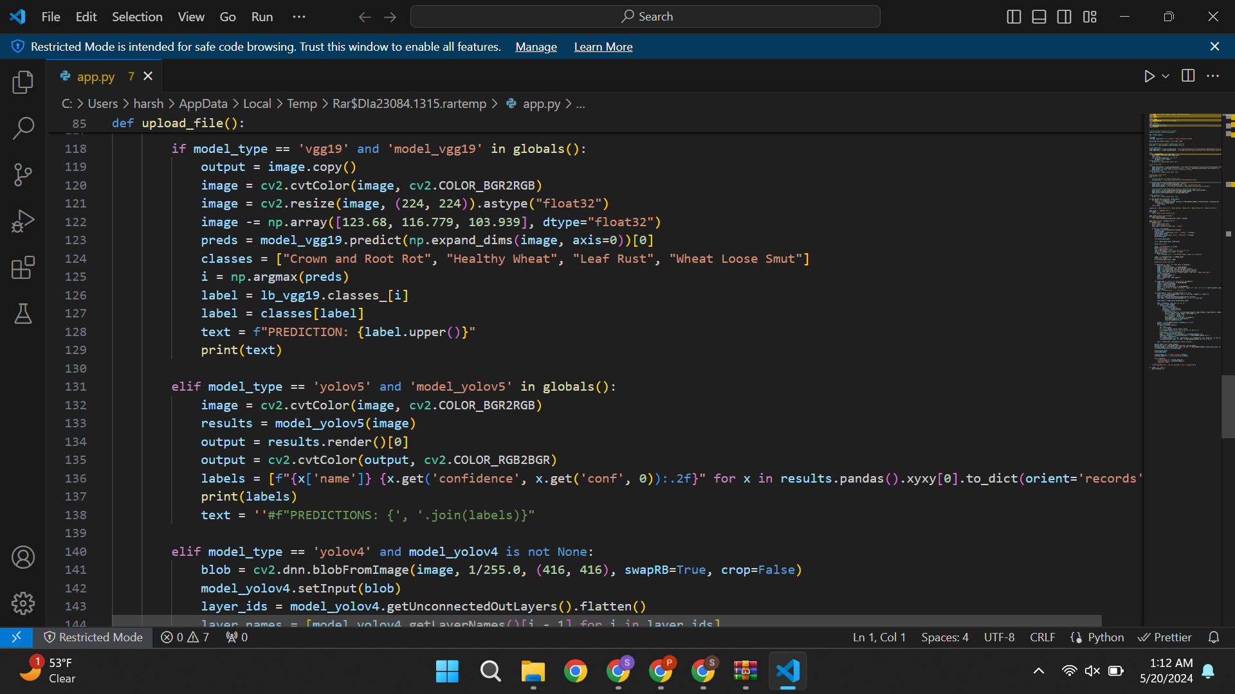
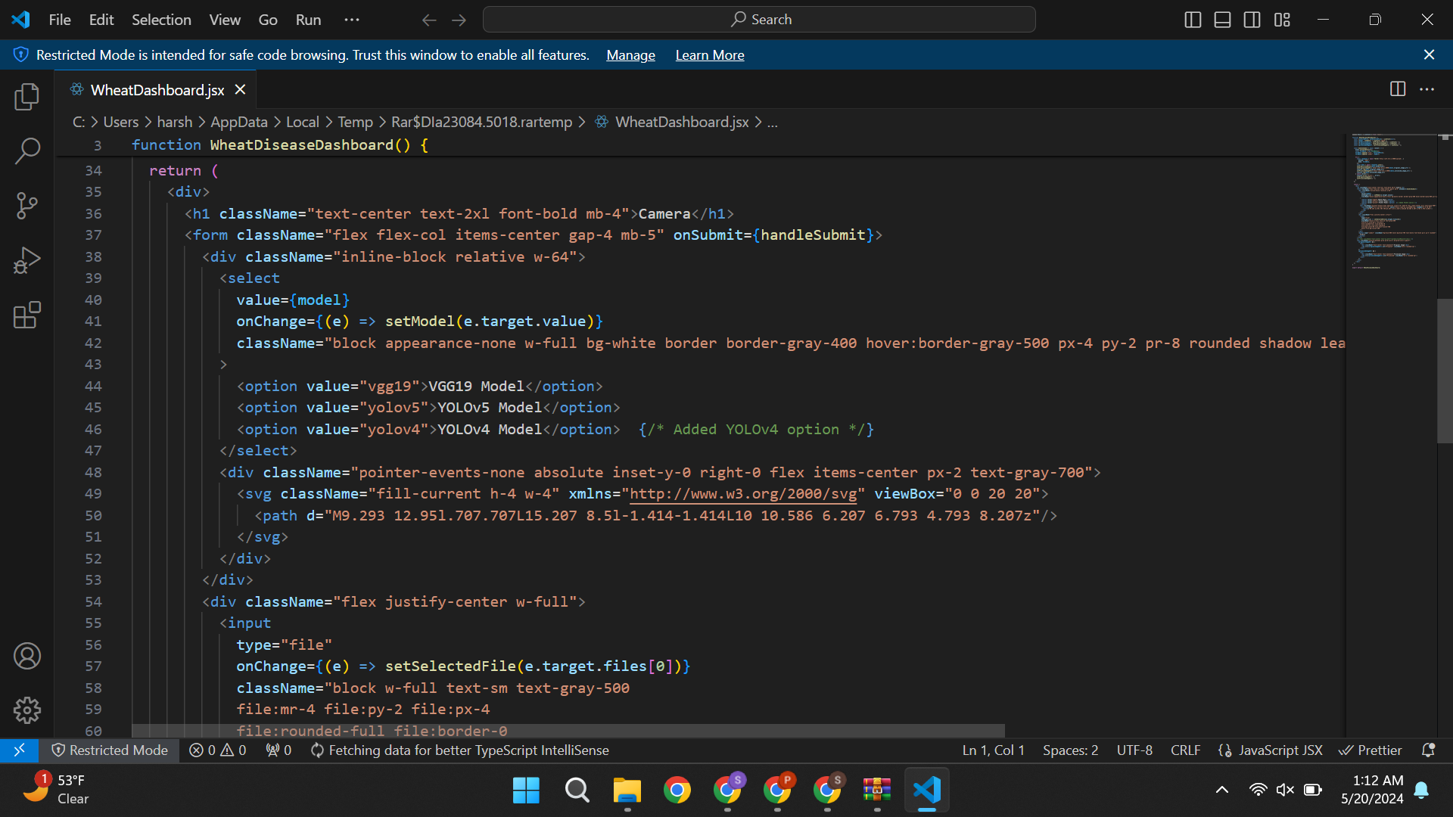
UI Code Snippets

Slide 40
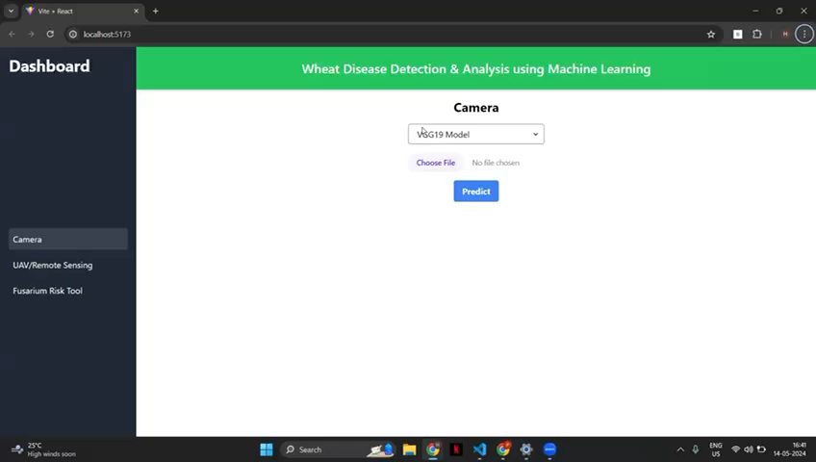
Demo

Slide 41
Comparative Study
VGG19 shows robust performance in wheat disease detection, achieving around 90% in precision and recall, with 92% training accuracy and 88% testing accuracy.
In contrast, YOLOv4 achieves 90% mAP@0.50, 80% precision, 83% recall, and an F-1 Score of 86.4%, indicating substantial improvements in specific metrics.
Meanwhile, YOLOv5 excels in targeted detection tasks, notably achieving a 96% F-1 Score for Fusarium Head Blight, reflecting its superior capability for specific conditions due to advanced model architecture and training optimizations.

Slide 42

Conclusion
Model Insights:
VGG19: Offers strong generalization across diverse conditions, ideal for broad-spectrum disease detection with high reliability.
YOLOv5: Best for targeted detection tasks, excelling in precision for specific diseases like Fusarium Head Blight, suitable for specialized applications.
Implementation Recommendations:
Use VGG19 for consistent, widespread disease monitoring.
Deploy YOLOv5 where detailed, precise disease identification is crucial.

Slide 43
References
D. Ashourloo, H. Aghighi, A. A. Matkan, M. R. Mobasheri, and A. M. Rad, "An Investigation Into Machine Learning Regression Techniques for the Leaf Rust Disease Detection Using Hyperspectral Measurement," IEEE Journal of Selected Topics in Applied Earth Observations and Remote Sensing, vol. 9, no. 9, pp. 4344-4351, Sep. 2016. DOI: 10.1109/JSTARS.2016.2525864.
Z. Sarayloo and D. Asemani, "Designing a classifier for automatic detection of fungal diseases in wheat plant by pattern recognition techniques," 23rd Iranian Conference on Electrical Engineering (ICEE), 2015.
A. Picon, A. Alvarez-Gila, M. Seitz, A. Ortiz-Barredo, J. Echazarra, and A. Johannes, “Deep convolutional neural networks for mobile capture device-based crop disease classification in the wild,” Comput. Electron. Agricult., vol. 161, pp. 280290, Jun. 2019, doi: 10.1016/j.compag.2018.04.002.
W. Haider, A. ur Rehman, and S. Z. Javed, "Crop Disease Diagnosis using Deep Learning Models," in Global Conference on Wireless and Optical Technologies (GCWOT), 2020. DOI: 10.1109/GCWOT49832.2020.9231436.
S. Nema and A. Dixit, "Wheat Leaf Detection and Prevention Using Support Vector Machine," in Proceedings of the 2018 IEEE International Conference on Circuits and Systems in Digital Enterprise Technology, Kottayam, India, 2018.
S. Sood, H. Singh, "An implementation and analysis of deep learning models for the detection of wheat rust disease," 2020 3rd International Conference on Intelligent Sustainable Systems (ICISS), pp. 341-347, 2020.
Z. Lin et al., "A Unified Matrix-Based Convolutional Neural Network for Fine-Grained Image Classification of Wheat Leaf Diseases," in IEEE Access, vol. 7, pp. 11570-11590, 2019.

Slide 44


